Slide 1

Health Services Administration
®
STERLING HSA
San
HSA Online Services
Notes:
1
Speaker introduction

Slide 2

WWW.STERLINGHSA.COM
EASY ACCESS FROM THE STERLING HSA HOME PAGE
Notes:
2

Slide 3
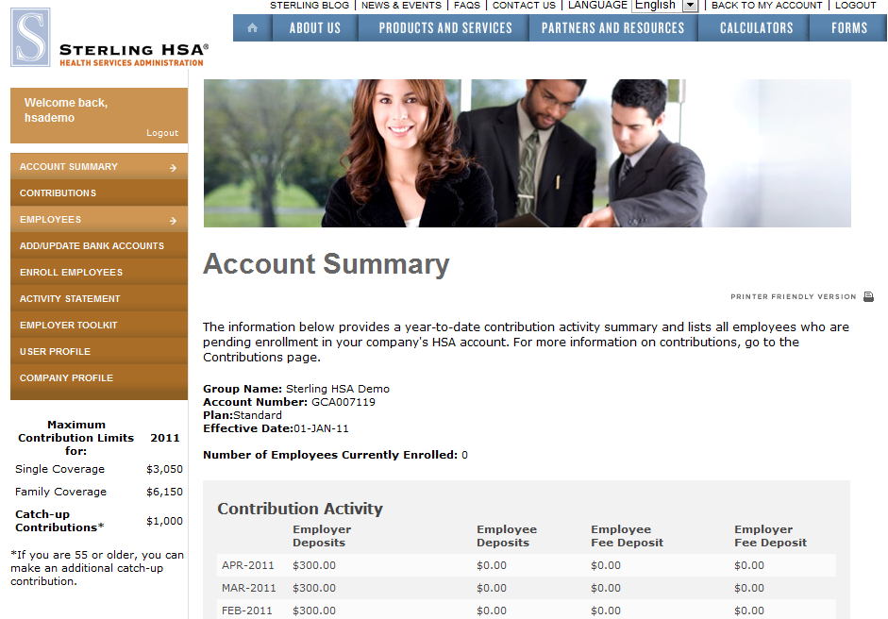
EMPLOYER HOME PAGE
Notes:
3

Slide 4
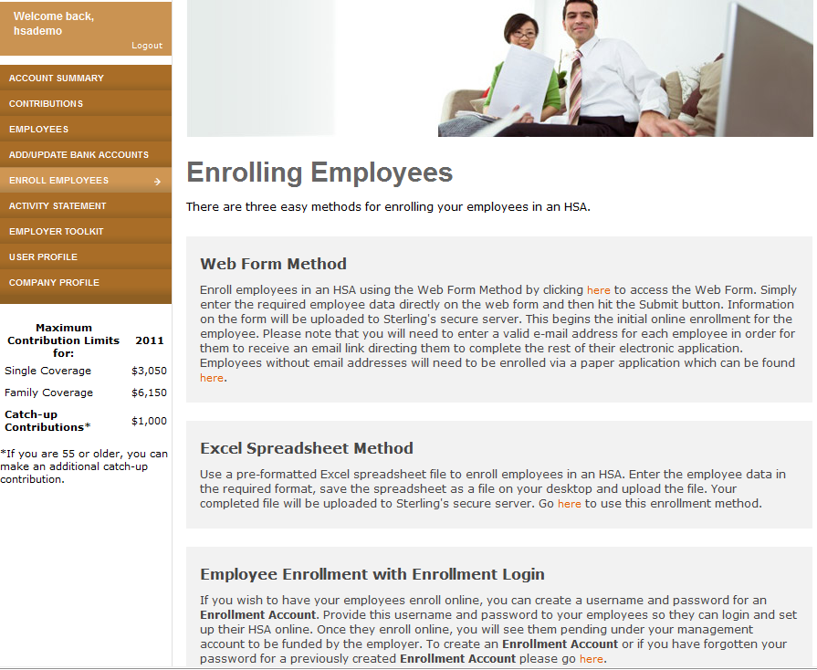
ENROLL EMPLOYEES
Notes:
4

Slide 5
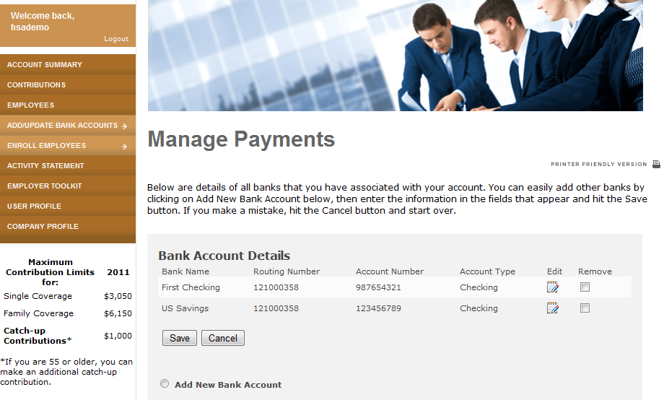
ADD/UPDATE BANK ACCOUNTS
Notes:
5

Slide 6
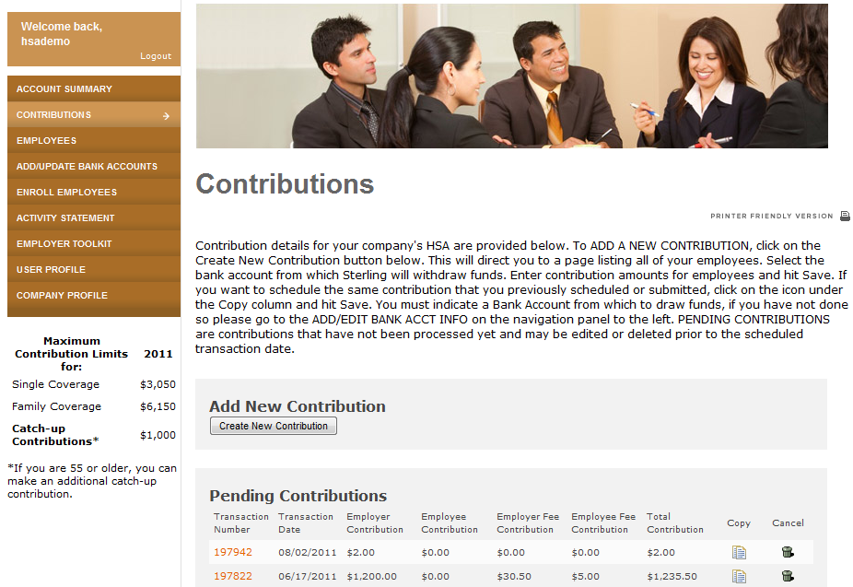
CONTRIBUTIONS
Notes:
6

Slide 7
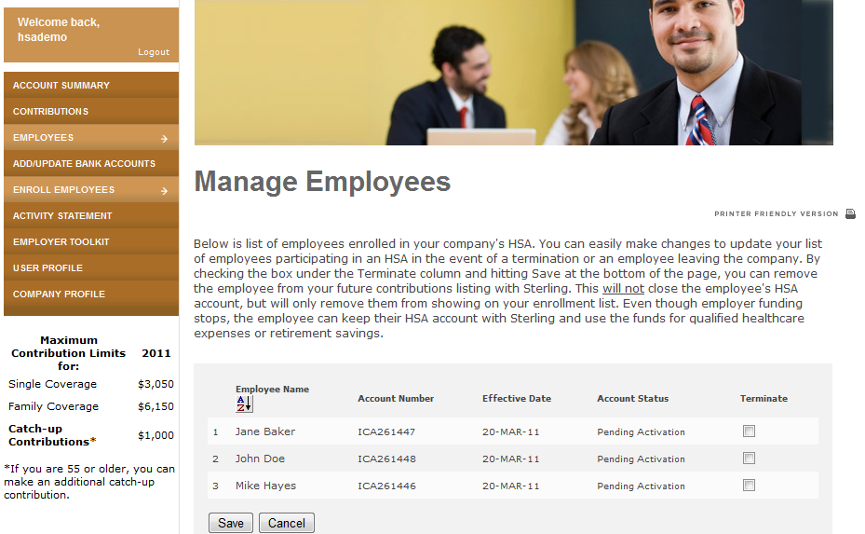
EMPLOYEES
Notes:
7

Slide 8
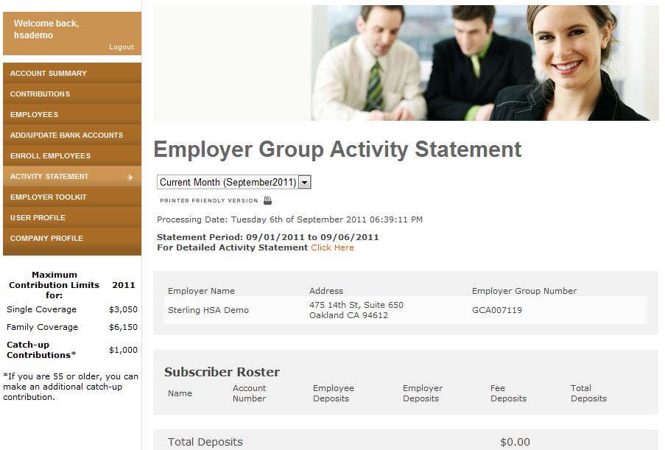
ACTIVITY STATEMENT
Notes:
8

Slide 9
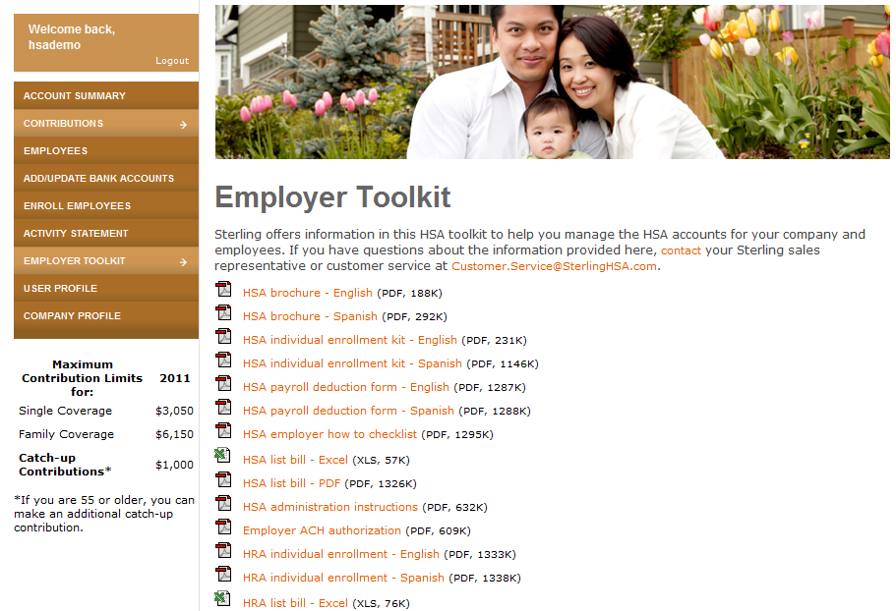
EMPLOYER TOOLKIT
Notes:
9

Slide 10
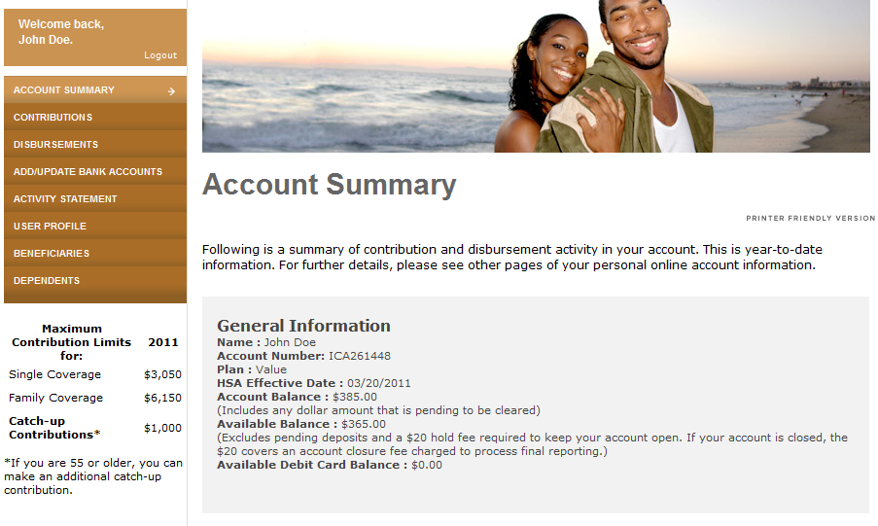
EMPLOYEE SELF-SERVICE PORTAL
Notes:
10

Slide 11
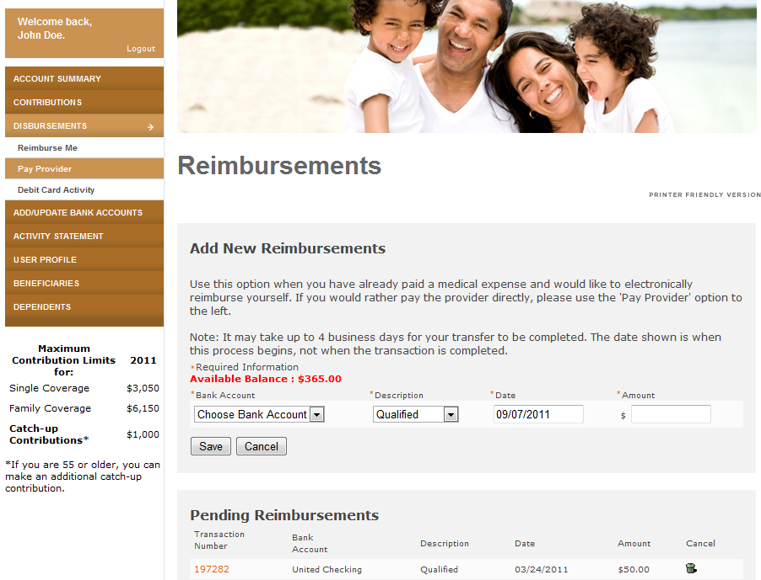
EMPLOYEE SELF-SERVICE PORTAL
Notes:
11

Slide 12
THANK YOU!
For more questions, contact:
Sterling HSA
475 14th Street, Suite 650
Oakland, CA 94612
Toll Free Phone: 800.617.4729
Toll Free Fax: 877.517.4729
Customer.Service@SterlingHSA.com
Notes:
12
Thank you for your time and attention! Any questions?

